Slide 1
Rounding to any number of decimal places
Task A: Rounding to a given number of decimal places
1) Complete the following table:
Number | to 1 d.p. | to 2 d.p. | to 3 d.p.
14.25342 | 14.3 | 14.25 | 14.253
765.3246 | 765.3 | 765.32 | 765.325
2035.83716 | 2035.8 | 2035.84 | 2035.837
7.658192 | 7.7 | 7.66 | 7.658
82.82926 | 82.8 | 82.83 | 82.829
0.63492 | 0.6 | 0.63 | 0.635
0.08739 | 0.1 | 0.09 | 0.087
0.2995 | 0.3 | 0.30 | 0.300
2) Using the clues, find the numbers being described:
a) Clue 1 − I am between 2 and 3.
Clue 2 − I have 3 digits after the decimal point.
Clue 3 − When rounded to 2 decimal places I am 2.88.
Clue 4 − My hundredths digit is greater than my thousandths digit.
Clue 5 − The difference between my tenths and thousandths digits is 2.
I am 2.876
b) Clue 1 − I am between 1 and 2.
Clue 2 − I have 3 digits after the decimal point.
Clue 3 − When rounded to 1 decimal place I am 1.9.
Clue 4 − When rounded to 2 decimal places I am 1.90.
Clue 5 − The sum of my tenths and thousandths column is 13.
I am 1.904 or 1.895

Slide 2
Rounding to any number of decimal places
2) Using the clues find the numbers being described:
c) Clue 1 − I am between 0 and 1.
Clue 2 − I have 3 digits after the decimal point.
Clue 3 − When rounded to 1 decimal place I am 0.1.
Clue 4 − When rounded to 2 decimal places I am 0.08.
Clue 5 − My hundredths column is double my thousandths column.
I am 0.084
Task B: Rounding in a context
1) 3 friends go out for lunch and spend £25. They decide that there are 3 different ways they can pay.
a) Write down the pros and cons of the different ways.
i) Round the cost to the nearest £10 and split the bill.
£25 ≈ £30 (to the nearest ten)
£30 ÷ 3 = £10
They pay £10 each.
They cover the cost of lunch but pay £5 more than they needed to.
ii) Split the bill between the 3 of them, round this to the nearest pound and each pay that amount.
£25 ÷ 3 = £8 (to the nearest pound)
£8 × 3 = £24
It is easy to work out but they are £1 short on the cost of lunch.
iii) Split the bill between the 3 of them, round to 2 decimal places and each pay that amount.
£25 ÷ 3 = £8.33 (to 2 d.p.)
£8 × 3.33 = £24.99
They each pay the same but they are 1 p short on the cost of lunch.
b) What should they do to pay for the lunch?
They should divide the cost by 3 but round up to the nearest penny.

Slide 3
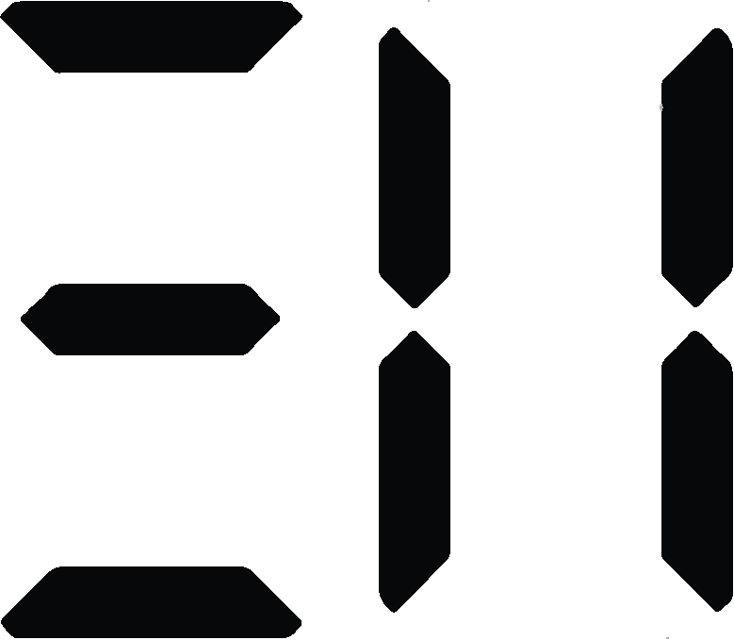
Rounding to any number of decimal places
2) Work out the cost of carpeting the following:
a)
b)
7.2 m
£6.25 per m²
7.2 × 6.8 = 49.0 m²
49.0 × 6.25 = £306.25
6.8 m
5.1 m
8.08 × 4.2 − 2.98 × 1.36 = 29.88 m²
29.88 × 5.95 = £177.79
4.2 m
£5.95 per m²
2.84 m
8.08 m
3) Lucas, Aisha and Jacob take part in 800 m on sports day. The teacher recorded their times to the nearest minute.
Here are their times:
Lucas Aisha Jacob
3 minutes 3 minutes 3 minutes
a) Was rounding to the nearest minute a suitable degree of accuracy?
No, because the times were all the same.
b) The teacher then decides to record their times to the nearest hundredth of a second. Is this an appropriate degree of accuracy?
Yes, this should definitely separate the pupils.
Here are their exact times :
Lucas Aisha Jacob
c) Was it necessary to record the times to the nearest 100th of a second?
It was not necessary, as you could tell from the tenths of a second.
Mathematics in Education and Industry
v2.3

